Slide 1


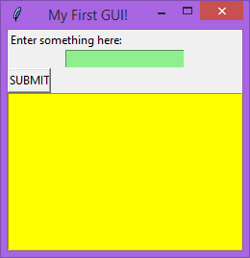
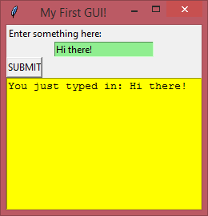
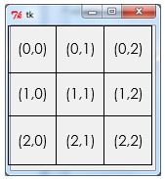
GUI Building with TKinter
Lesson 6 – entry validation

Slide 2


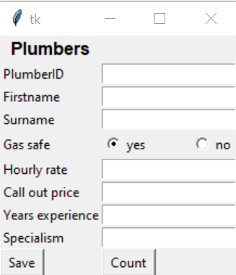

Activity 1
Create a new Tkinter file and create label, entry box and radio button widgets to make it look like the window shown on the right.
Each widget you include needs to have a StringVar variable attached to it. For example, the “Years experience” entrybox widget can be made using the code shown below.
Save your code as “lesson 6 activity 1”

Slide 3
Today’s lesson
Introduction
Last lesson you saw the first example of an exam question involving Tkinter where you counted the number of records matching certain criteria.
Today you’ll be continuing with the next part of this past paper which involves creating a new input form and adding validation to the user entry.
Learning Objectives:
Understand what is meant by the term “validation”
Investigate the various different sorts of validation check
Practise the code necessary for implementing validation checks on user entry in Tkinter

Slide 4
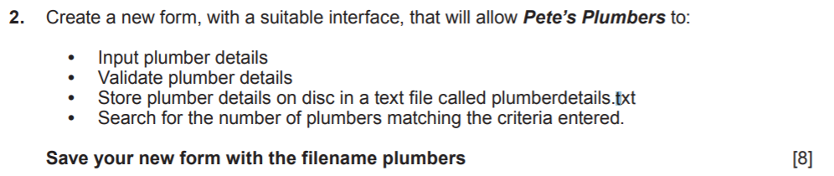
Tkinter – entry validation
Past paper question part 2
This task combines several skills we’ve learned so far. If you’ve completed activity 1 then you’ve already done the first bullet point.
We’ll implement the saving and counting like we did in the previous lesson, then add validation to the saving code later on.

Slide 5
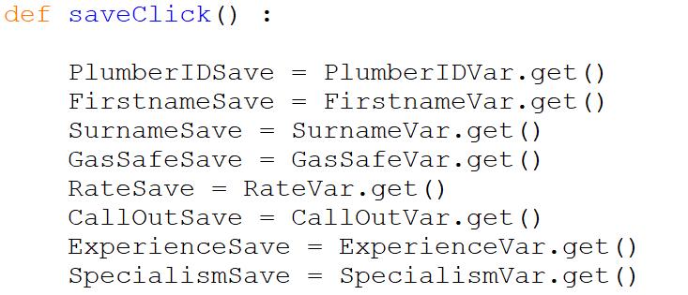
Tkinter – entry validation
Saving & counting
Now we’ll make a function to go with the save button. Like you’ve done in previous lessons, make a new function called “saveClick”.
Here’s the start of the saveClick function:

Slide 6
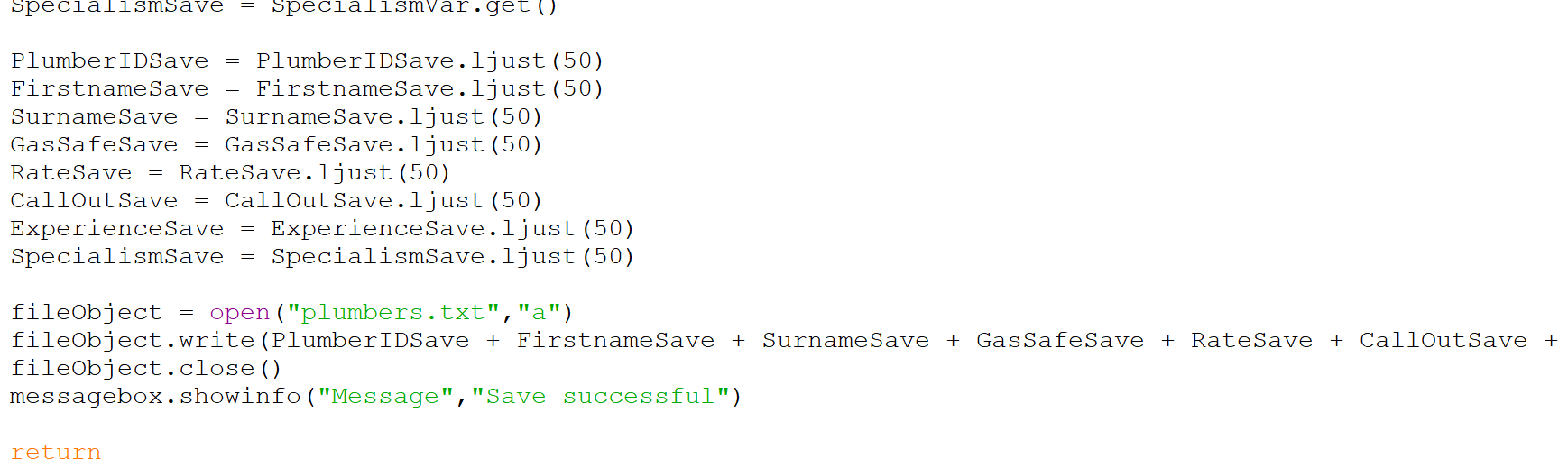
Tkinter – entry validation
Saving & counting
For the purposes of this tutorial, I’m going to be using the WJEC method of saving and counting (no dictionary, using “ljust(50)” to create a table in the text document).
Because we’ve used stringVars to handle all of the input and we don’t have checkboxes, the save code is going to be easier this time.
Screenshot missing the last two variables here, make sure you include “ExperienceSave” and “SpecialismSave”

Slide 7
Tkinter – entry validation
Saving & counting
Test that the saving works, then make a new “countClick” function to go with the count button.
In the previous lesson, you implemented counting for the questionnaire program. Open your solution to that lesson now.
You won’t need as much code for this function this time – we are using string variables to handle the inputs, and there are no checkboxes to deal with.
Using your code from last lesson, try to implement a count function for your new plumber program.

Slide 8
Activity 2
Using the code you did in lesson 5, complete the “saveClick” and “countClick” functions so that data can be saved to a file and counted.
Save your code as “lesson 6 activity 2”

Slide 9
Tkinter – entry validation
Validation
When users are asked to enter data into a form, they are prone to making mistakes or perhaps don’t take it very seriously.
The programmer needs to put something in place to prevent the user from entering invalid data.
Invalid data could be a word entered when the form wanted a number, or perhaps just leaving a necessary field blank.

Slide 10
Tkinter – entry validation
Validation
There are 5 different validation checks you need to know about:
We will be looking at how to implement all of these except format checks – these are more complex and aren’t required to get the marks, but it will be included as optional extension work later.
Type
Checking that the data entered is the right data type
E.g. an integer has been entered instead of a string
Range
Checking that a number entered is in a valid range
E.g. an age of a person should not be below 0 or above 150
Format
E.g. for a date, it should be DD/MM/YYYY or similar
Checking that something like a date, car registration number or postcode has the right layout
Length
Checking that what has been entered is a valid length
E.g. most website accounts require a password which is at least 6-8 characters long
E.g. you might have a maximum length of word you can enter into a system
Presence
Checking that the user has actually entered something when input is required
E.g. if you leave a box blank on some website forms, it will flag up red and say you need to put data in

Slide 11
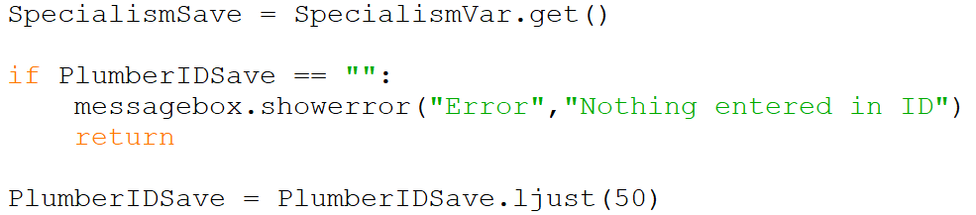
Tkinter – entry validation
Saving & validating
We’ll start with the simplest – a presence check. Go back to the saveClick function, and make space between the last “.get()” line and first “.ljust(50)” line as shown below, inserting the if statement code to perform the validation.
Checks to see if the variable is an empty string, indicating nothing entered
Ends the function prematurely so that the save is cancelled.

Slide 12
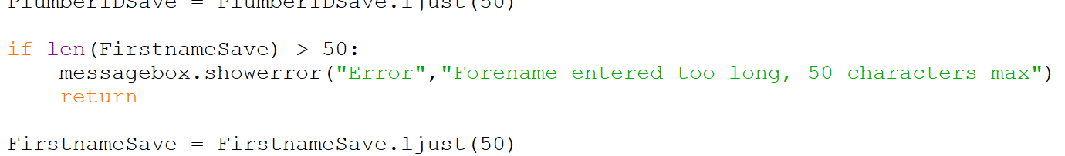
Tkinter – entry validation
Saving & validating
Next we’ll add in a length check for the first name entry. Because we are setting up our text file table to store data in 50 character chunks, the data can’t be longer than 50 characters in length.
Checks to see if the length of the variable is greater than 50
As with the last check, we need to provide the user with a detailed message explaining what they’ve done wrong.

Slide 13
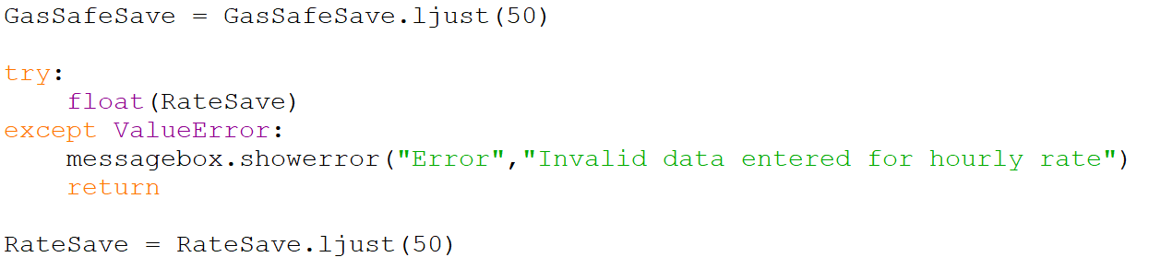
Tkinter – entry validation
Saving & validating
We’ll skip the next few variables for now – you will be asked to return to these later to add appropriate checks.
Make space in between the gas safe and rate save.ljust(50) lines and insert the code shown below to perform a type check:
Casts the RateSave variable to a float. If there is anything other than a number in the value of this variable, and error will occur…
…which we catch with this line.

Slide 14
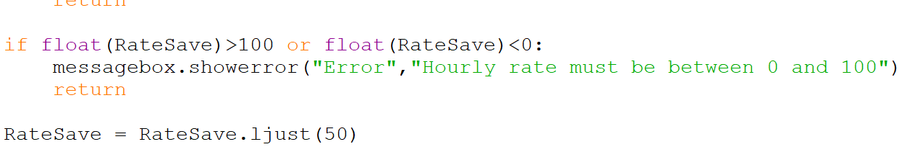
Tkinter – entry validation
Saving & validating
Staying with the RateSave variable we’ll also a range check in. Underneath the type check but before the “.ljust(50)” line, add in the following if statement:
To perform the numerical comparison for the range check, we need to cast the variable to a float again.
The numbers chosen here are a bit arbitrary. If the exam question tells you what the acceptable range should be then use that, otherwise just use some sensible numbers. The important bit is the range check, not the numbers!

Slide 15
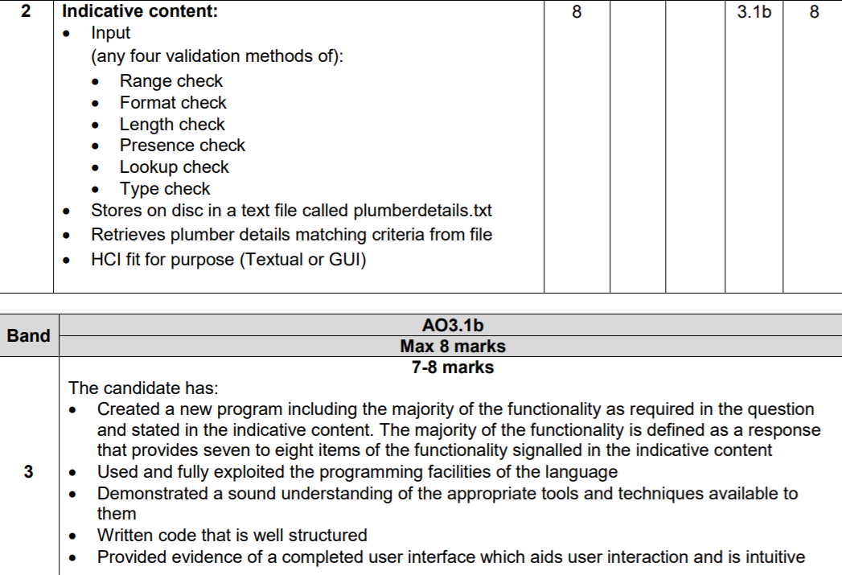
Tkinter – entry validation
Saving & validating
Now you know how to implement the 4 different validation checks, add in appropriate for all of the different entry handling variables.
Every variable should have at least 1 bit of validation, but you can add in more than 1 for each. Here’s what you’re aiming for according to the mark scheme:

Slide 16
Activity 3
Add input validation to all of the entry variables, with at least 1 check on each variable.
Save your work as “lesson 6 activity 3”.

Slide 17
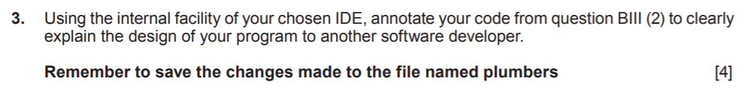
Tkinter – entry validation
Past paper question part 3
This is the final part of the Tkinter question on this particular exam paper. It basically requires you to add comments to your code to explain what it’s doing.

Slide 18
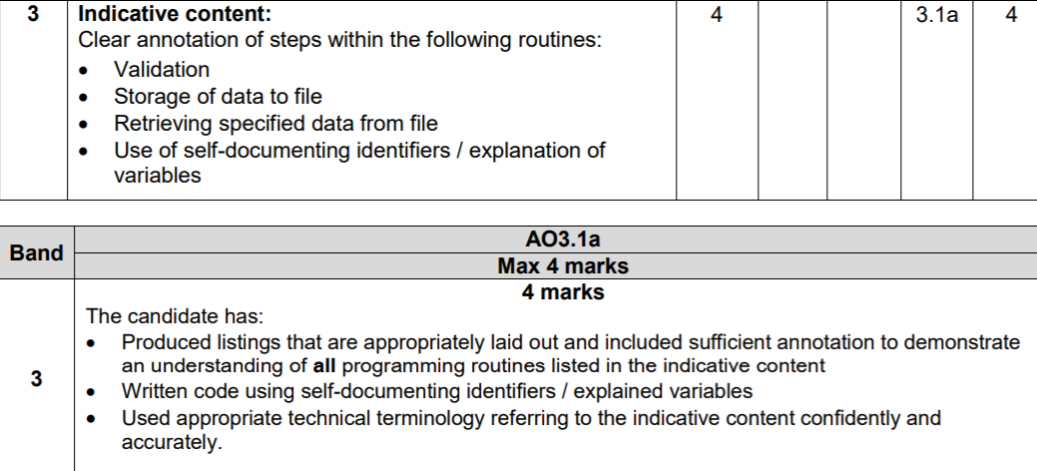
Tkinter – entry validation
Past paper question part 3
Here’s what the mark scheme requires in order for you to get 4 marks for this part:

Slide 19
Tkinter – entry validation
Past paper question part 3
Here’s an example of a line inside the type check validation code that has been commented appropriately:

Slide 20
Tkinter – entry validation
Past paper question part 3
Using # to add comments to the end of lines in Python, work through the code adding annotations now, focusing on the elements mentioned in the mark scheme.
Not every single line needs to be commented however – if it is a repeat of a previous line, don’t bother commenting it.
Go back through the tutorials for this lesson and the previous lesson if you aren’t sure what a line of code is doing!

Slide 21
Activity 4
Add comments to your code which explain in detail what the different lines are doing.
Save your work as “lesson 6 activity 4”.

Slide 22
Uploading your work
You should now have 4 complete Python files from today’s lesson. On Google classroom you will find an assignment for this lesson, and you need to upload your completed Python file to this assignment.
If you have any problems doing this, please speak to your teacher.

